Slide 1
Consolidating Artifacts and Designing a Dependency Management Strategy

Slide 2
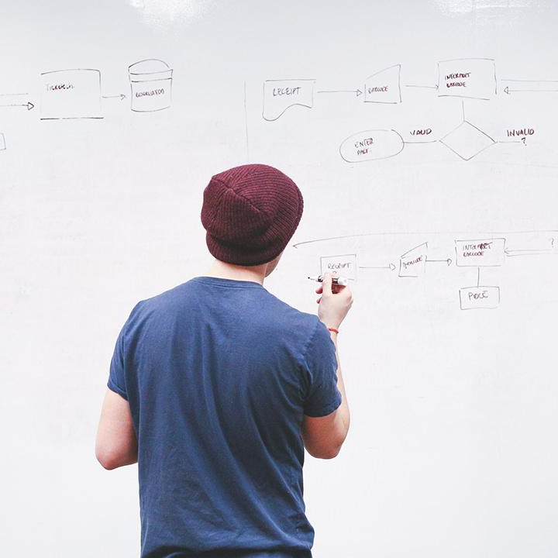
HELLO!
I am Eng Teong Cheah
Microsoft MVP
You can find me at @walkercet

Slide 3
Package Dependencies
1

Slide 4
What is dependency management
Modern software development
Dependencies on other projects and solutions

Slide 5
Elements of a dependency management strategy
Standardization
Package formats and sources
Versioning

Slide 6
Source and package componentization
Source componentization
Package componentization

Slide 7
Scanning your codebase for dependencies
Duplicate code
High cohesion and low coupling
Individual lifecycle
Stable parts
Independent code and components

Slide 8
Package Management
2

Slide 9
Packages
The components you relay and depend upon in your software solution.
A way to store those components in well defined format with metadata

Slide 10
Types of packages
NuGet
NPM
Maven
PyPi
Docker

Slide 11
Package feeds
Stored in a centralized place for distribution and consumption by others to take dependencies on the components it contains.

Slide 12
Private and public feeds
Public
NuGet.org
Npmjs.org
PyPi.org
Docker Hub
Private feeds
MyGet
Azure Container Registry
Azure Artifacts
Self-hosted solution

Slide 13
Package feed managers
Installation and removal of local packages
Pushing packages to a remote package feed
Consuming packages from a remote package feed
Searching feeds for packages

Slide 14
Azure Artifact – Types of package supported
NuGet packages
NPM packages
Maven
Universal packages
Python

Slide 15
THANKS!
Any questions?
You can find me at
@walkercet

Slide 16
CREDITS
Microsoft Docs

